Slide 1
bigBERD: an R package to generate reproducible analysis
Biostatistics Intern, UTHSC
P Winston Miller

Slide 2
In a nutshell..
Requires:
Clean data in an RData file
Consistent ordering of data
Should not be used inside a .Rmd notebook
Cases are rows
Variables are columns
Generates:
Organized report directory
Summarization file
Copy of the clean dataset
Exploratory analysis .Rmd document
Univariate Analysis .Rmd document
Multiple regression .Rmd document

Slide 3

1. Organized Report Directory
Name:
  Report_*date of generation*
Called:

Slide 4
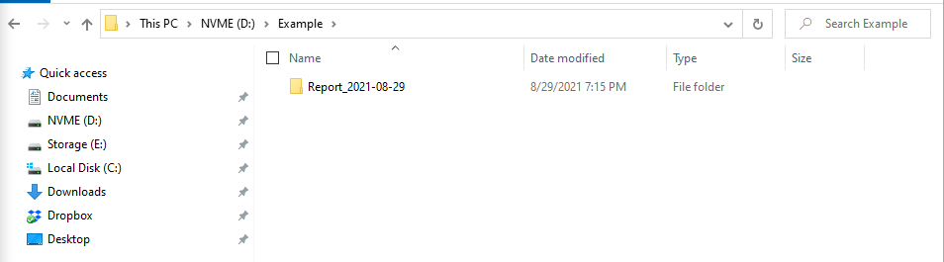
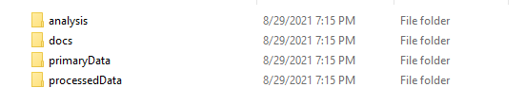
1. Organized Report Directory
Output:

Slide 5
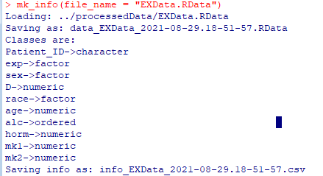
2. Summarization File info_*name of dataset*_*date.time generated*.csv

Slide 6
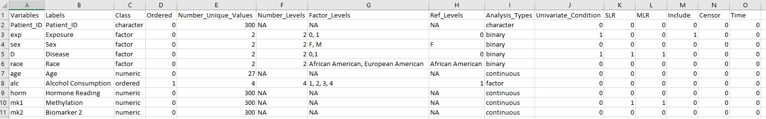
Informs bigBERD of data contents so that it can make appropriate decisions
Provides a brief summarization of input dataset for analyst

Slide 7
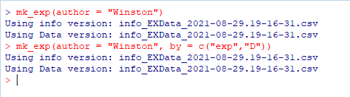
3. Exploratory Analysis
Name:
  Exploratory_Analysis_*data.time*.Rmd
Called:
2 parameters:
  Author: required
  By: controls bivariate plot generation

Slide 8
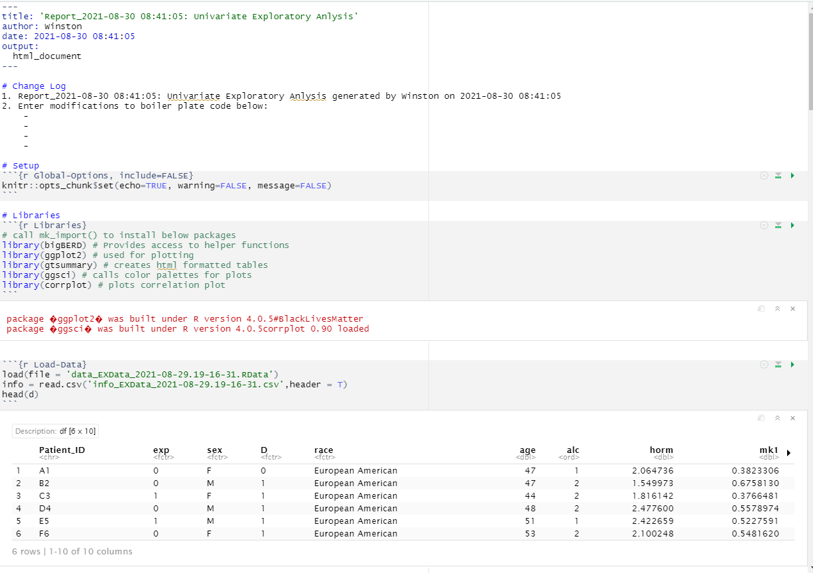

Slide 9
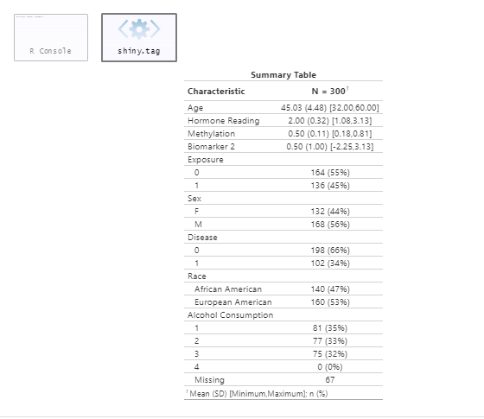

Slide 10
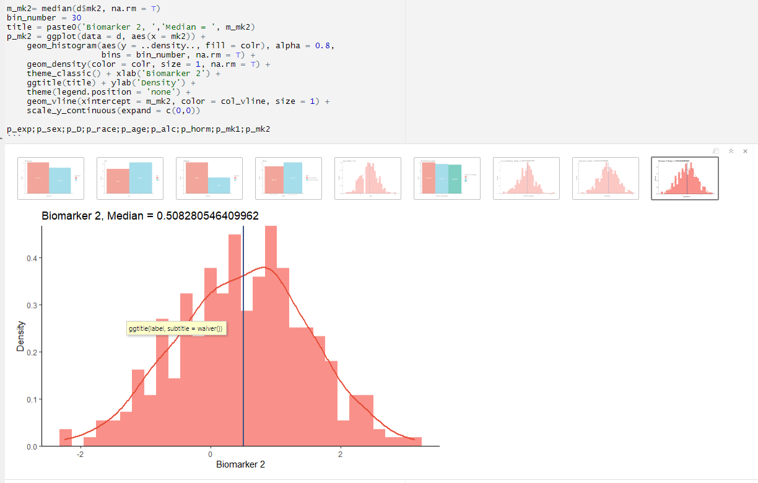

Slide 11
3. Exploratory Analysis
Name:
  Exploratory_Analysis_*data.time*.Rmd
Called:
2 parameters:
  Author: required
  By: controls bivariate plot generation

Slide 12
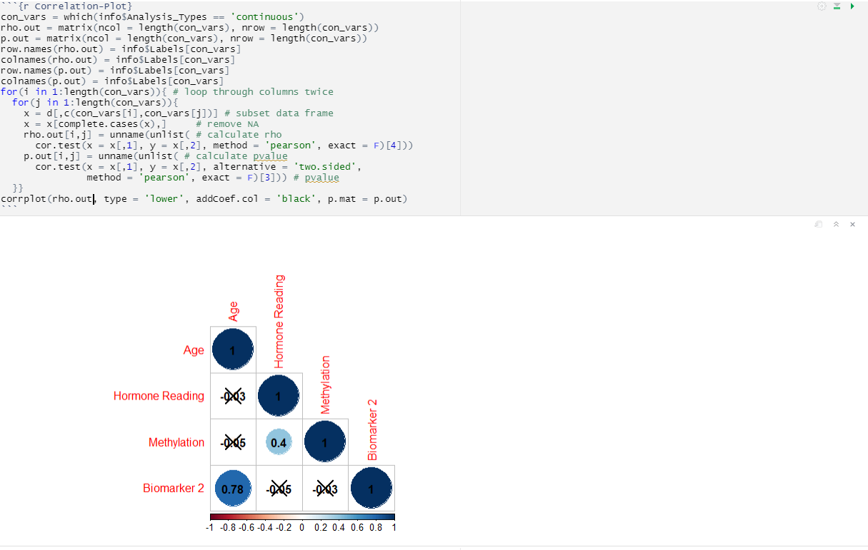

Slide 13
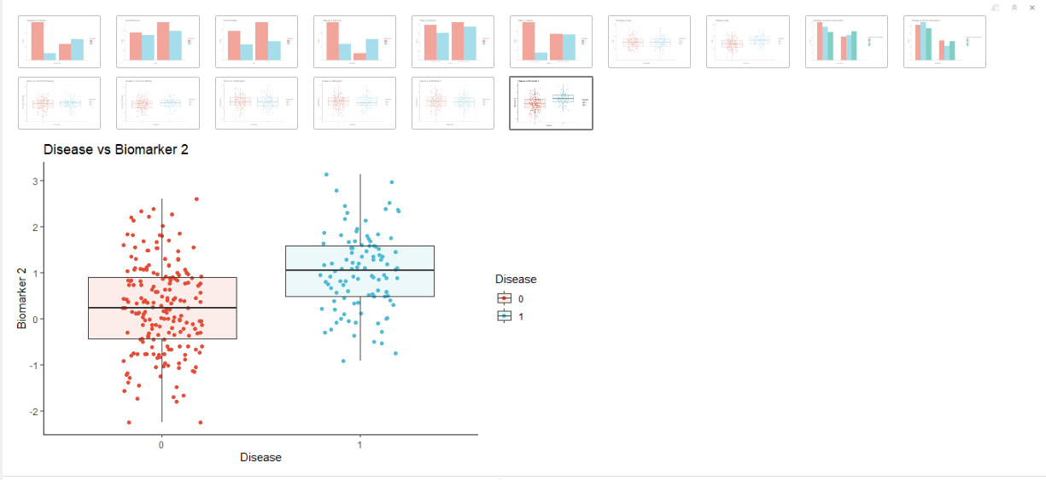

Slide 14
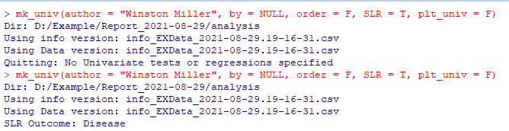
4. Univariate Analysis
Name:
  Univariate_Analysis_SLR _*data.time*.Rmd
  Univariate_Analysis _*data.time*.Rmd
Called:
Parameters of 2 Types:
Within the function call:
  By
  Order
  SLR
  Plt_univ
2. Within the info file:
  Univariate_Condition
  SLR

Slide 15
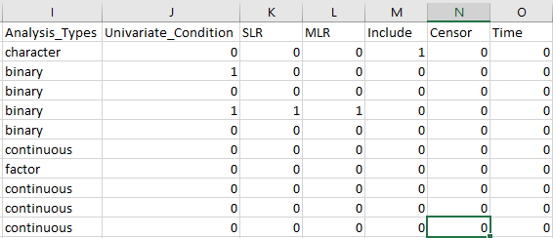

Slide 16
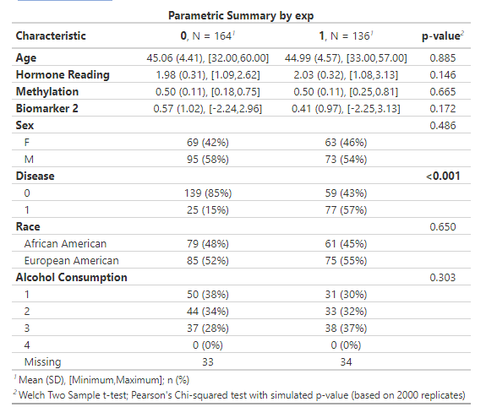
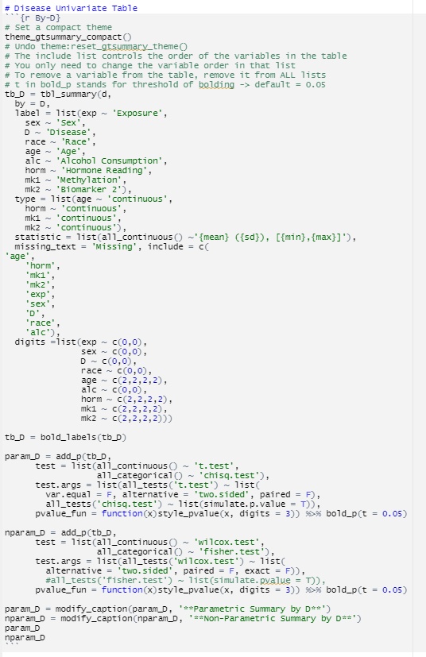
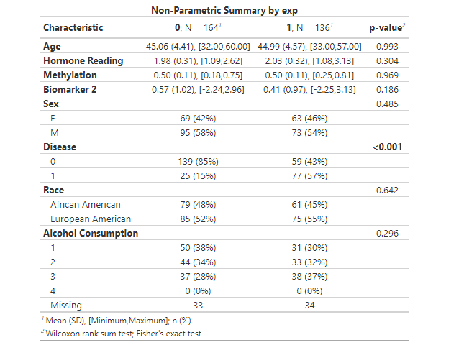

Slide 17
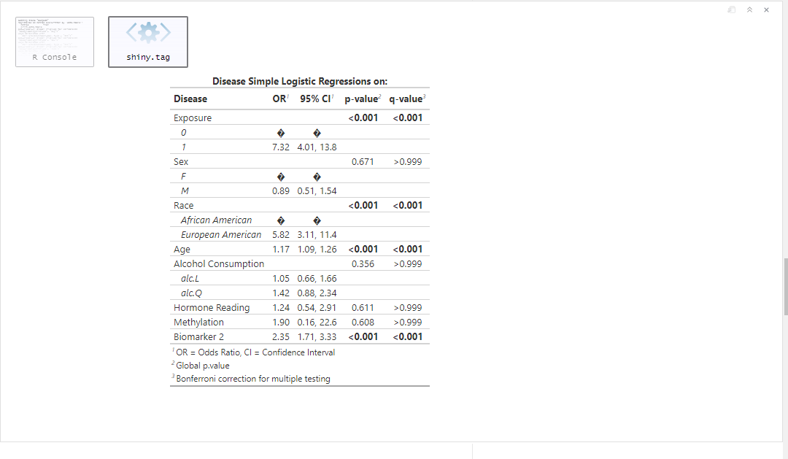
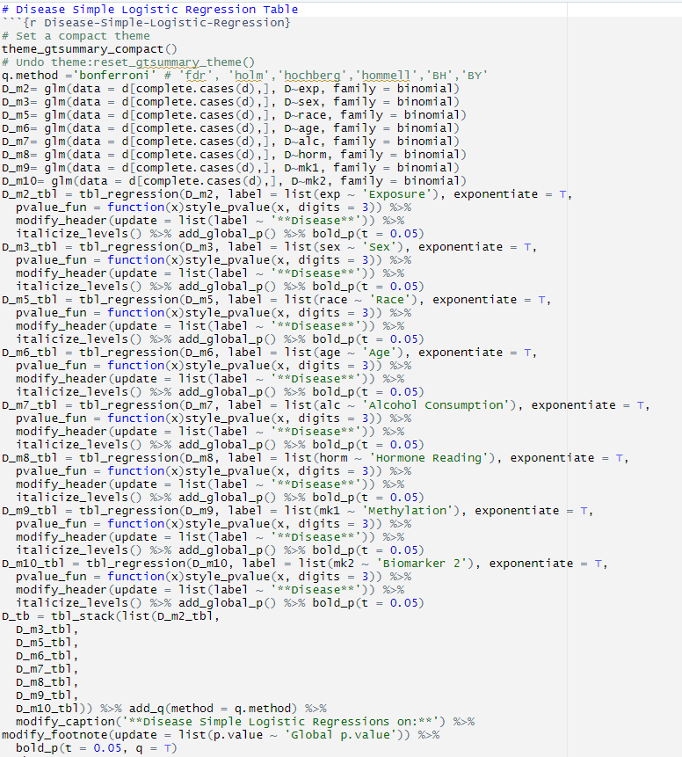

Slide 18
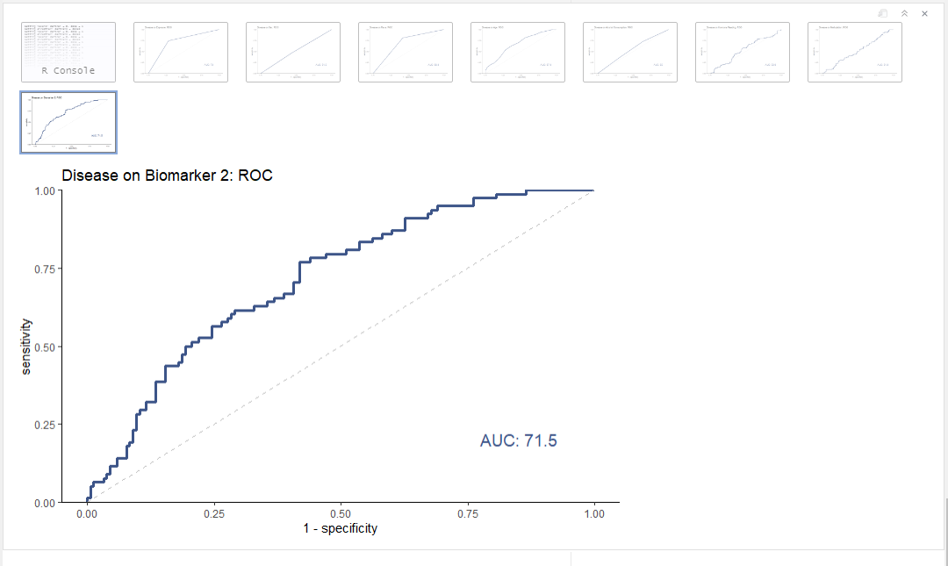

Slide 19
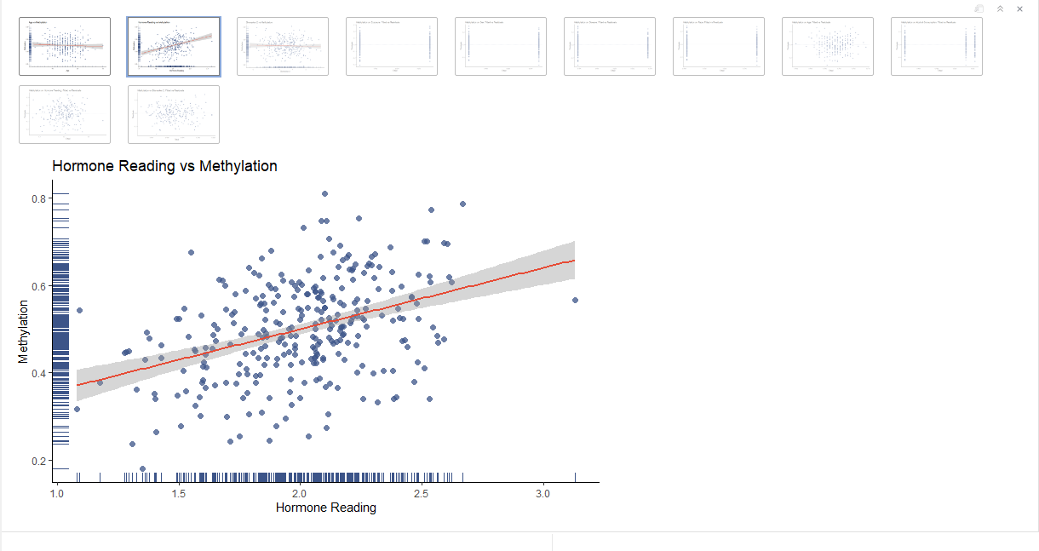

Slide 20
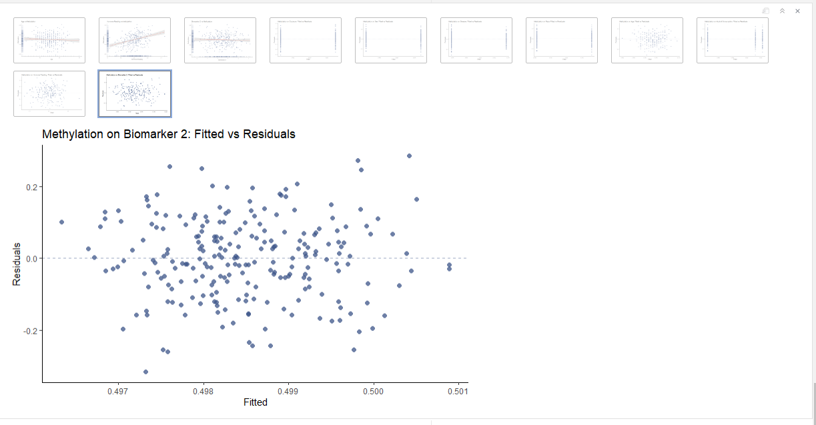

Slide 21
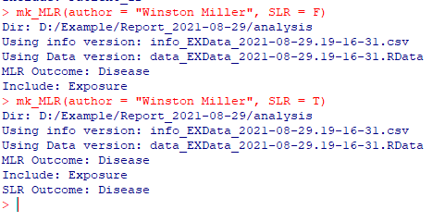
5. Multiple Regression Analysis
Named:
  MLR_Analysis_*data.time*. Rmd
  MLR_SLR_Analysis_*data.time*. Rmd
Called:
Parameters of 2 Types:
Within the function call:
  Author
  SLR
2. Within the info file:
  MLR
  Include
  SLR

Slide 23
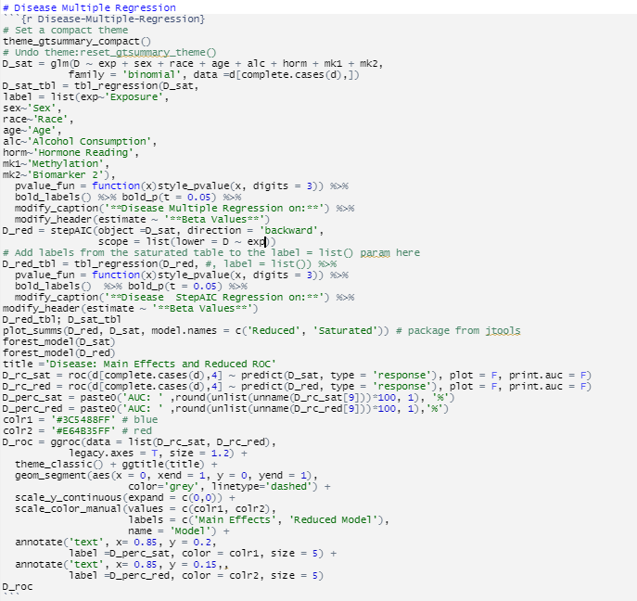

Slide 24
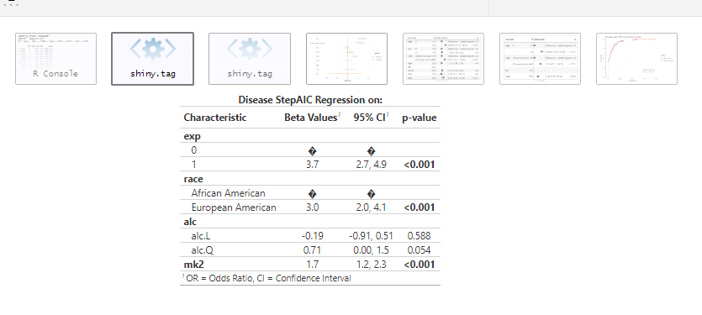

Slide 25
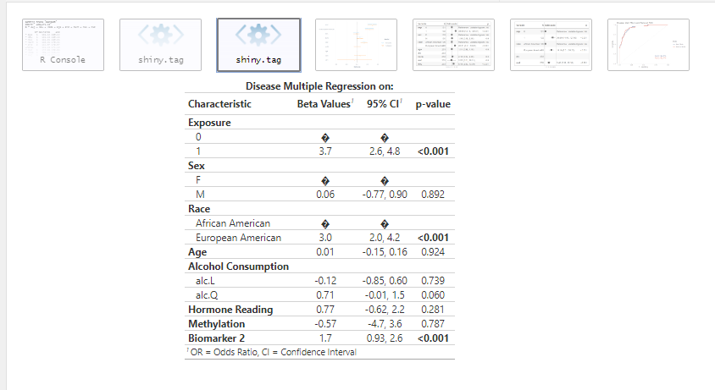

Slide 26
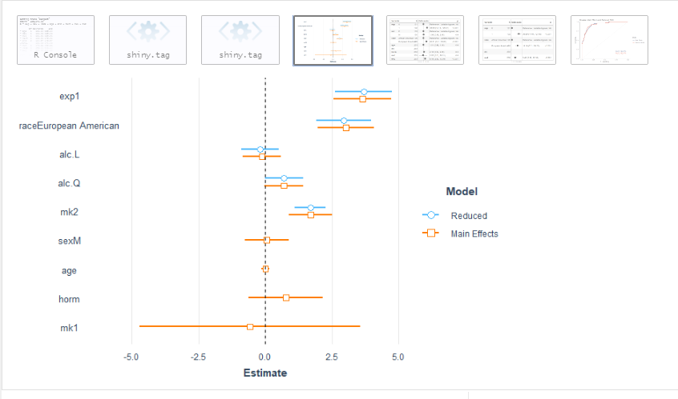

Slide 27
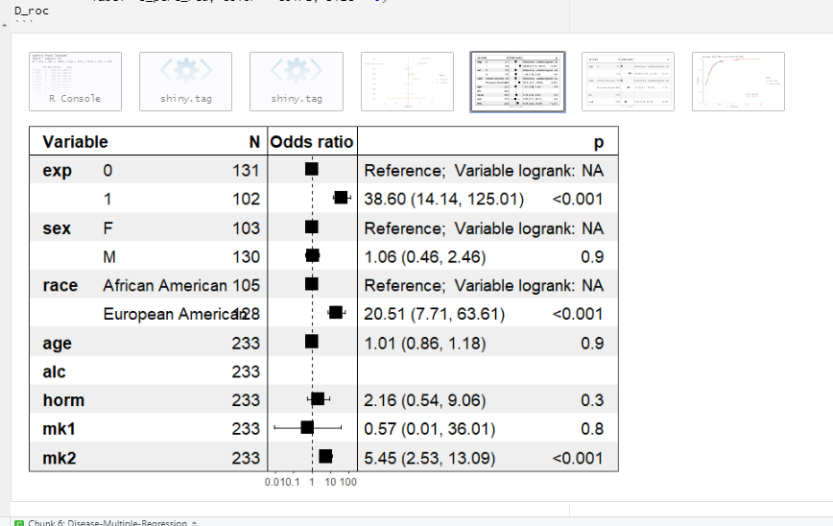

Slide 28
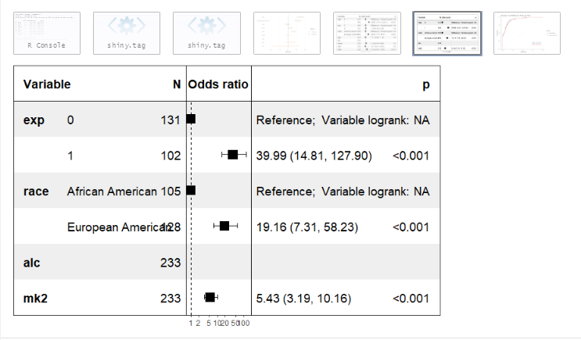

Slide 29
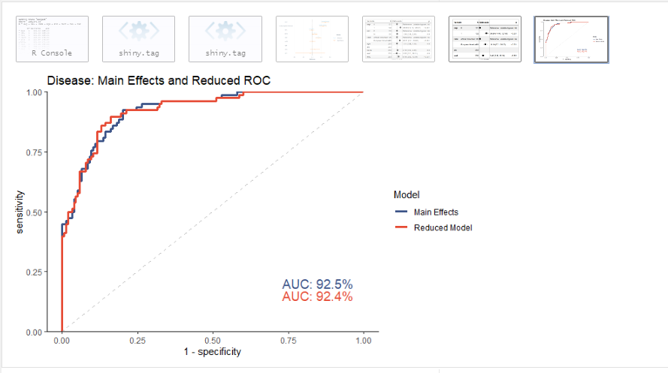

Slide 30
Future Directions
Upgrade info summary file (excel, conditional formatting)
Clean up multiple regression plots (develop proprietary function)
Finish documentation for package
General code cleanup
________________________________________
Add multiple regression for ordinal and multinomial models
Add options for different stepwise procedures
Plot improvements
Additional Diagnostic Plots
Detection of large variable input
Modify tabling code

Slide 31
Thank you to my mentors:
Tristan Hayes
Dr. Fridtjof Thomas
Dr. Mehmet Kocak

Slide 32
Questions?

